Slide 1
PROJECT NAME
BANKRUPTCY PREVENTION

Slide 2
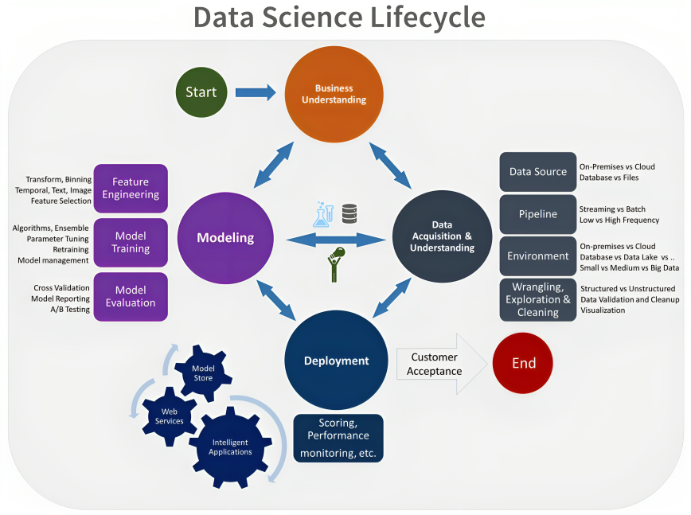
FLOW OF PROJECT
Importing the Required Libraries
Loading the Dataset
Data Exploration
Descriptive Statistics
Exploratory Data Analysis
Model Building
Model Validation
Model Deployment

Slide 3
BUSINESS OBJECTIVE
This is a classification project, since the variable to predict is binary (bankruptcy or non-bankruptcy). The goal here is to create models which predicts that a business goes bankrupt from different features.

Slide 4
ABOUT THE DATASET
The data file contains 7 features about 250 companies
The data set includes the following variables:
industrial_risk: 0=low risk, 0.5=medium risk, 1=high risk.
management_risk: 0=low risk, 0.5=medium risk, 1=high risk.
financial flexibility: 0=low flexibility, 0.5=medium flexibility, 1=high flexibility.
credibility: 0=low credibility, 0.5=medium credibility, 1=high credibility.
competitiveness: 0=low competitiveness, 0.5=medium competitiveness, 1=high competitiveness.
operating_risk: 0=low risk, 0.5=medium risk, 1=high risk.
class: bankruptcy, non-bankruptcy (target variable).

Slide 5
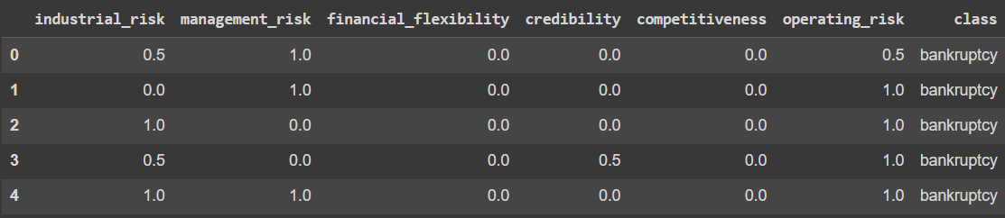
UPLOADING THE DATASET

Slide 6
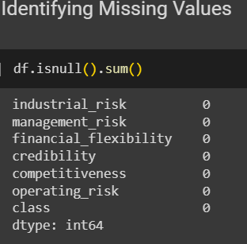
CHECKING MISSING VALUES

Slide 7
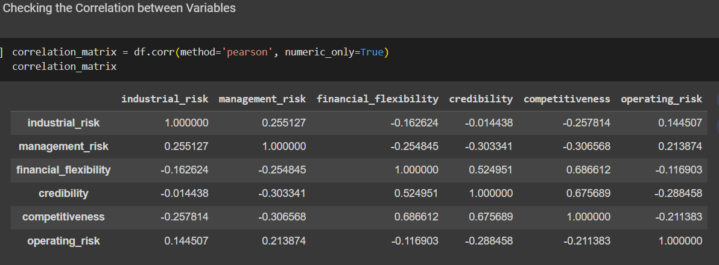
EDA (CHECKING CORRELATION)

Slide 8
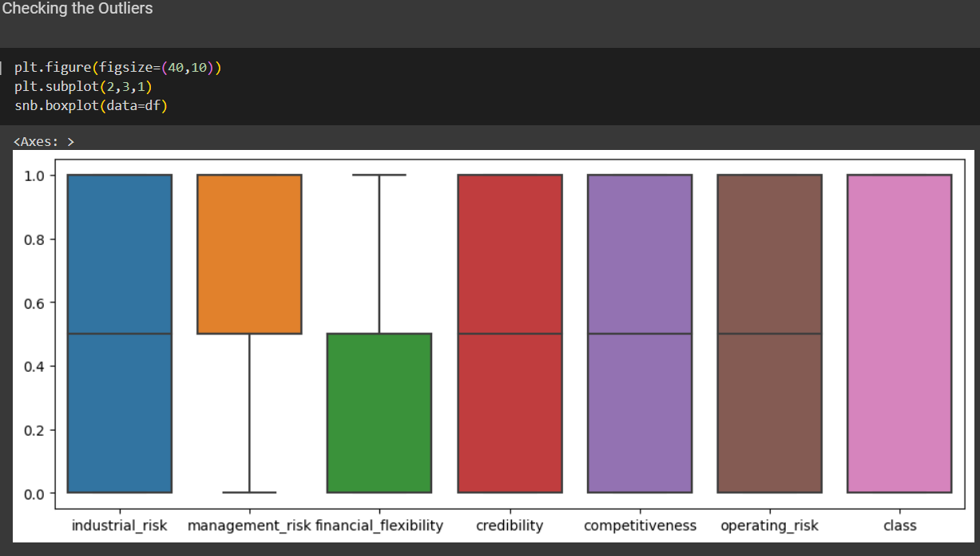
IDENTIFYING OUTLIERS

Slide 9
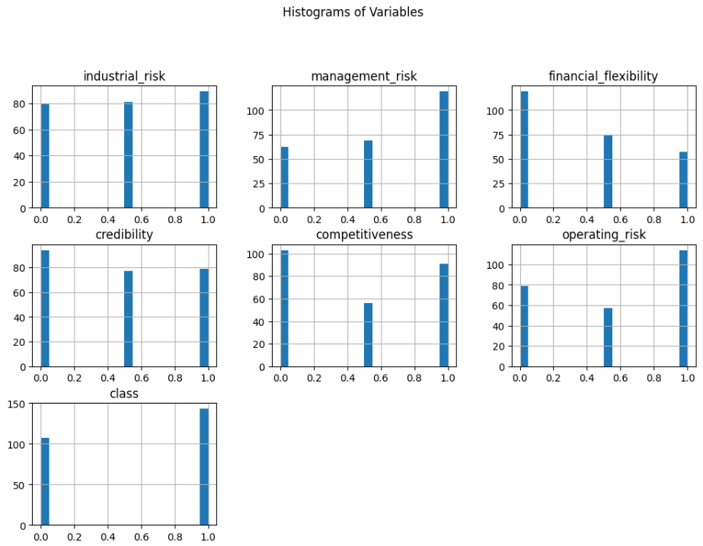
VISUALIZATION (HISTOGRAM)

Slide 10
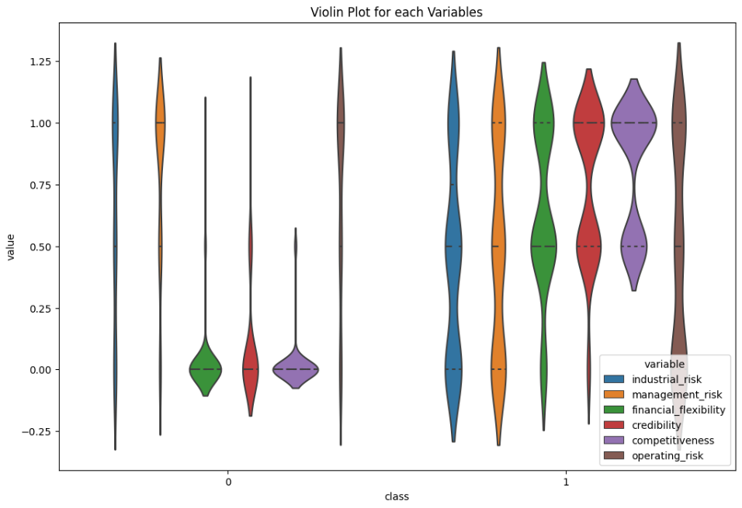
VIOLIN PLOT

Slide 11
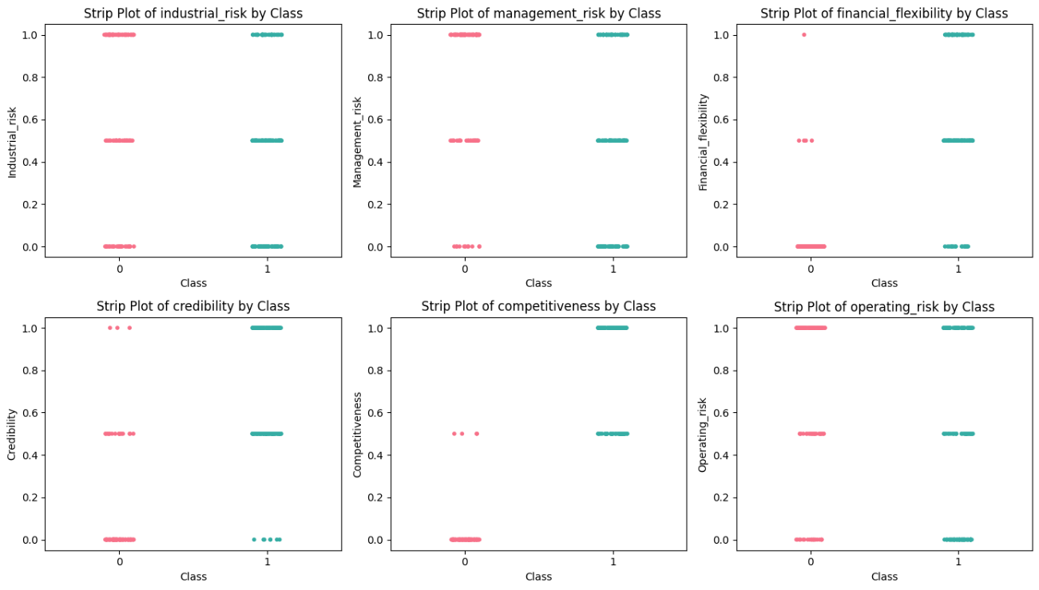
SWARM PLOT

Slide 12
MODEL BUILDING

Slide 13
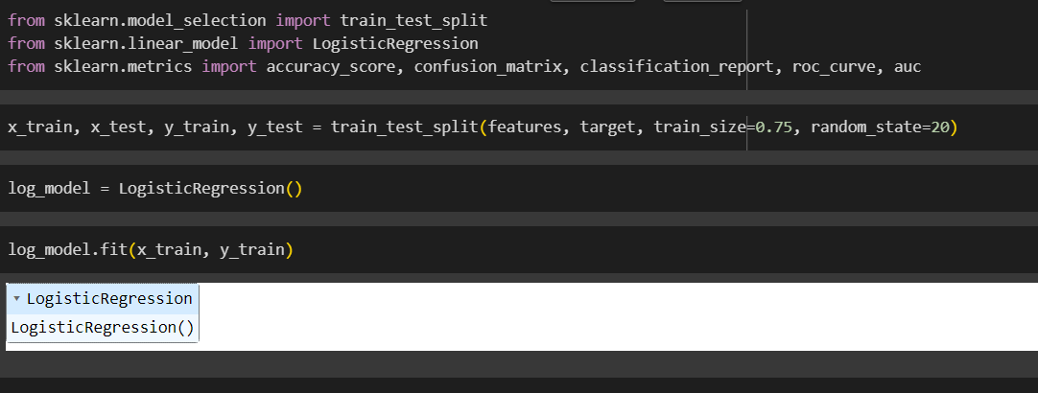
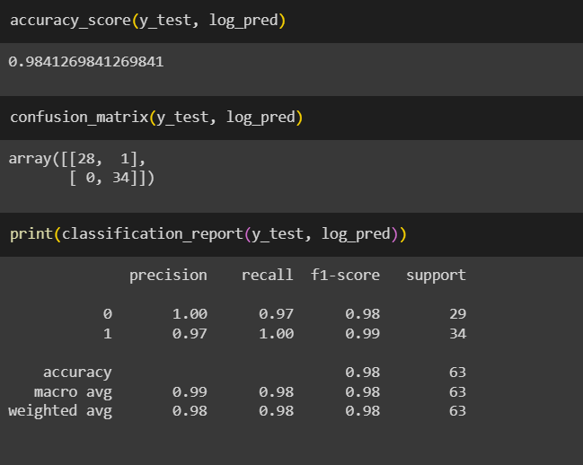
LOGISTIC REGRESSION MODEL
SPLITTING & TRAINING THE DATA
ACCURACY OF THE MODEL

Slide 14
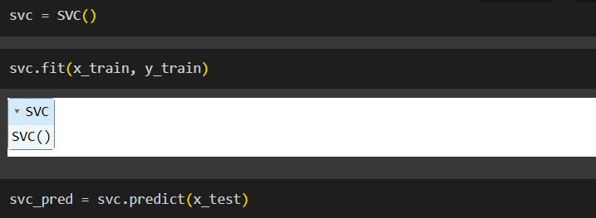
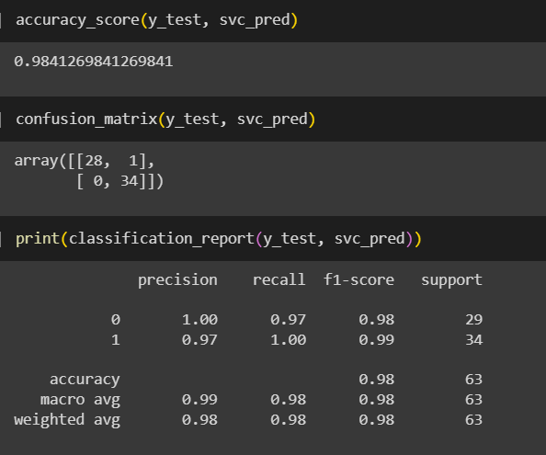
SVC MODEL
TRAINING THE MODEL
ACCURACY OF MODEL

Slide 15
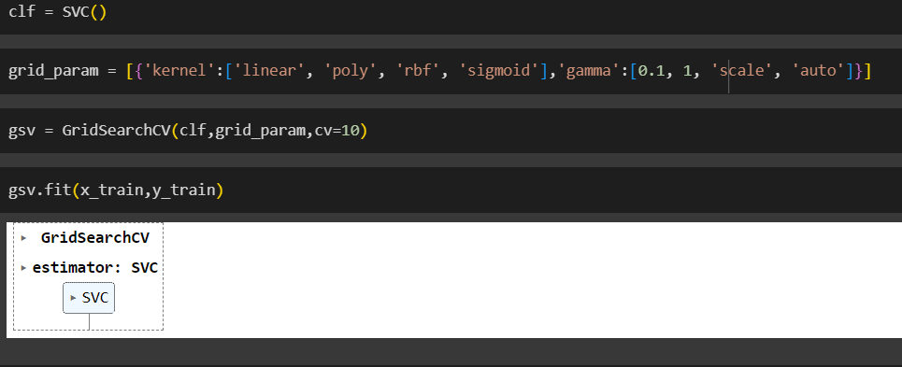
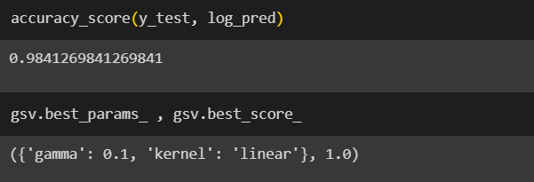
GRID SEARCH CV MODEL
TRAINING THE MODEL
ACCURACY OF MODEL

Slide 16
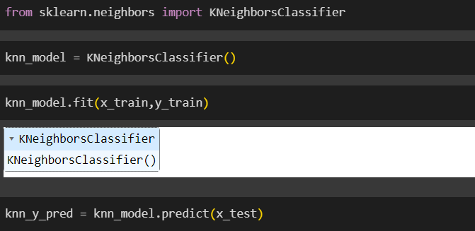
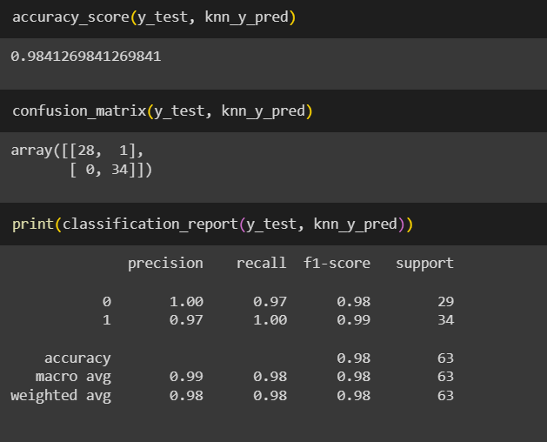
KNN MODEL
TRAINING THE MODEL
ACCURACY OF MODEL

Slide 17
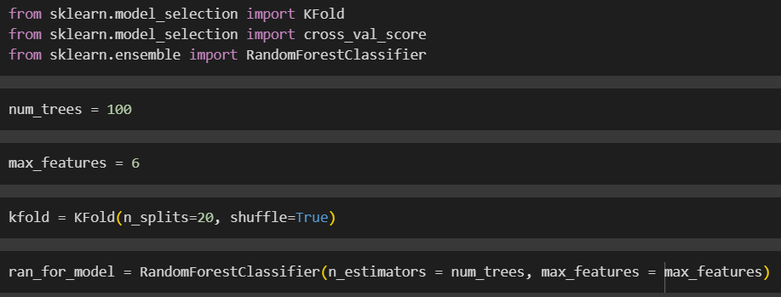
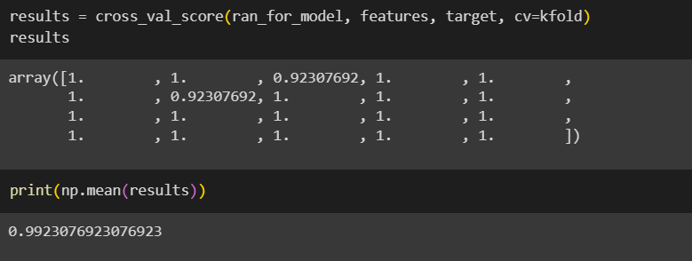
RANDOM FOREST MODEL
TRAINING THE MODEL
ACCURACY OF MODEL

Slide 18
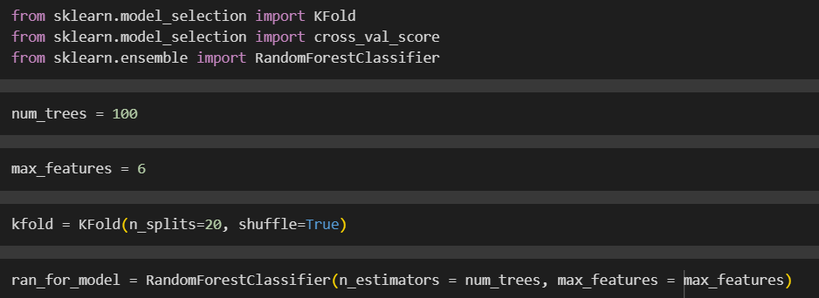
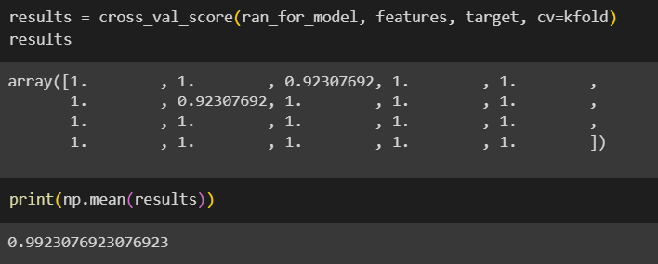
DECISION TREE
TRAINING THE MODEL
ACCURACY OF MODEL

Slide 19
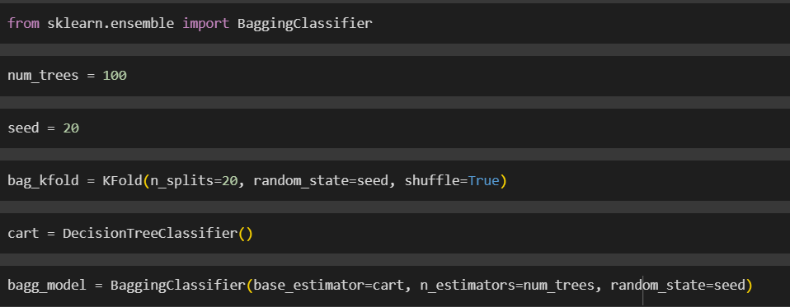
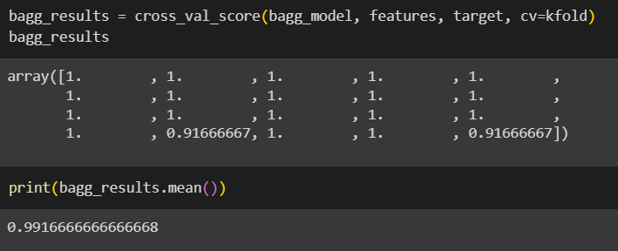
BAGGING TECHNIQUE
TRAINING THE MODEL
ACCURACY OF MODEL

Slide 20
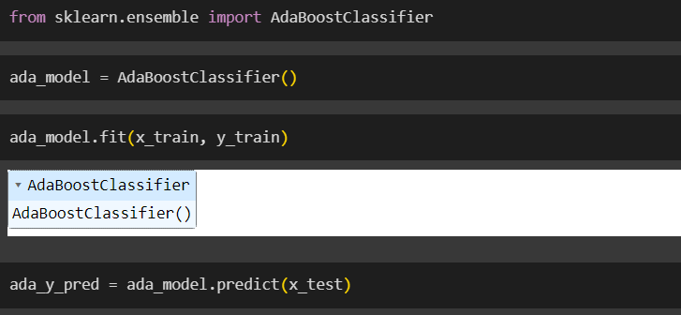
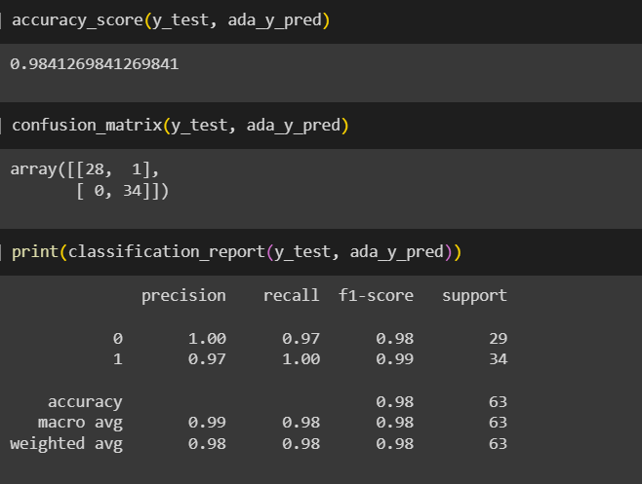
ADABOOST TECHNIQUE
TRAINING THE MODEL
ACCURACY OF MODEL

Slide 21
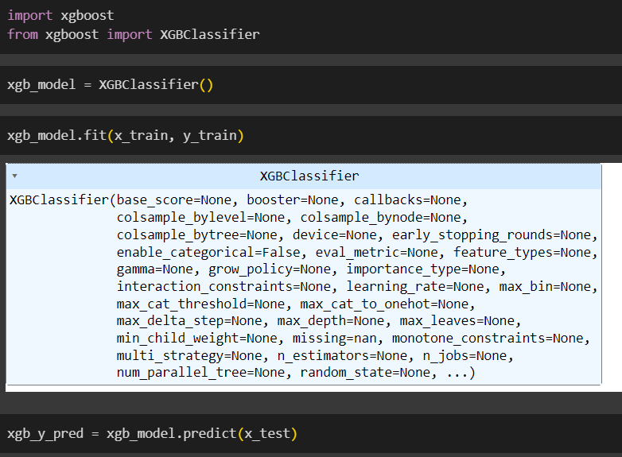
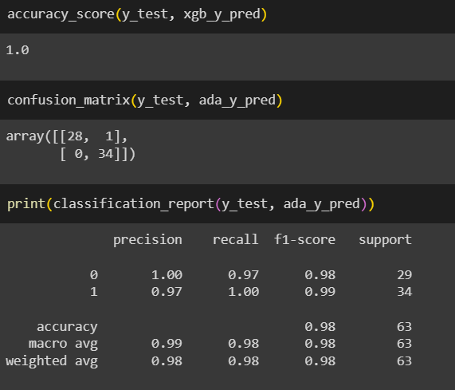
XGBOOST TECHNIQUE
TRAINING THE MODEL
ACCURACY OF MODEL

Slide 22
MODEL EVALUATION & VALIDATION

Slide 23
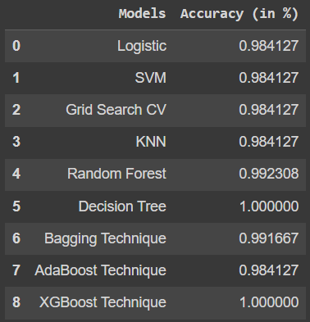
ACCURACY TABLE OF ALL MODELS

Slide 24
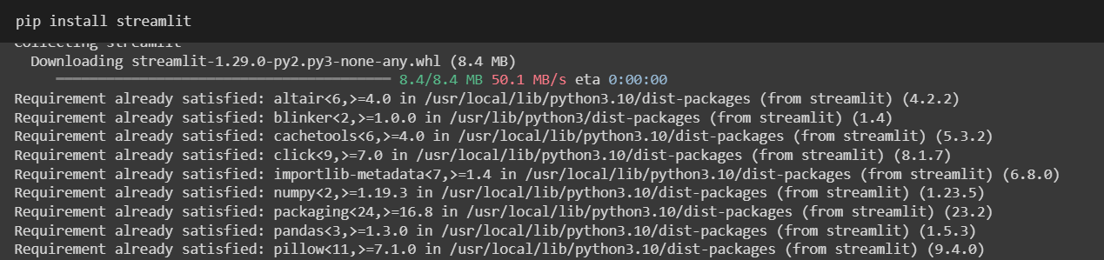
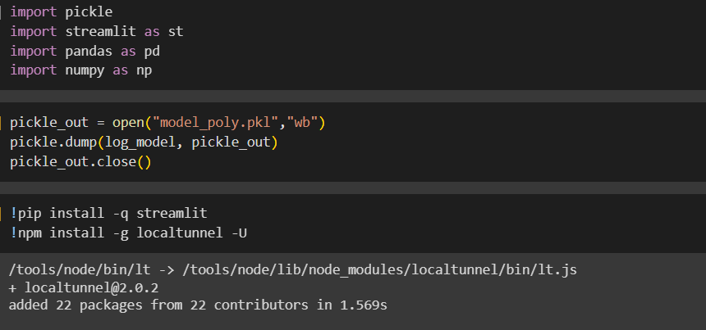
MODEL DEPLOYMENT USING STREAMLIT

Slide 25
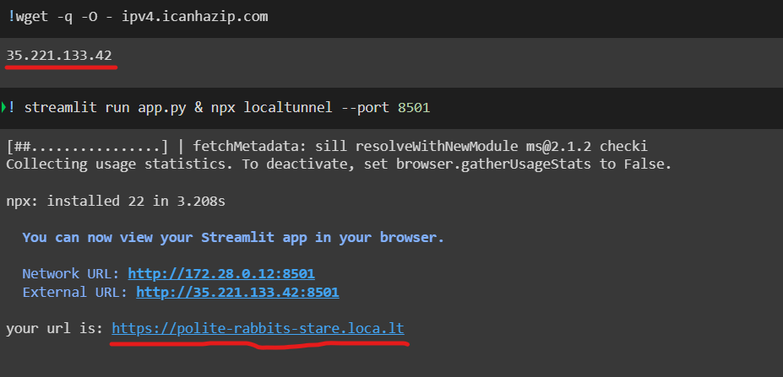
We need to copy the Marked IP Address then we must visit the Marked URL and Paste the IP to view the UI of the Bankruptcy Detector

Slide 26
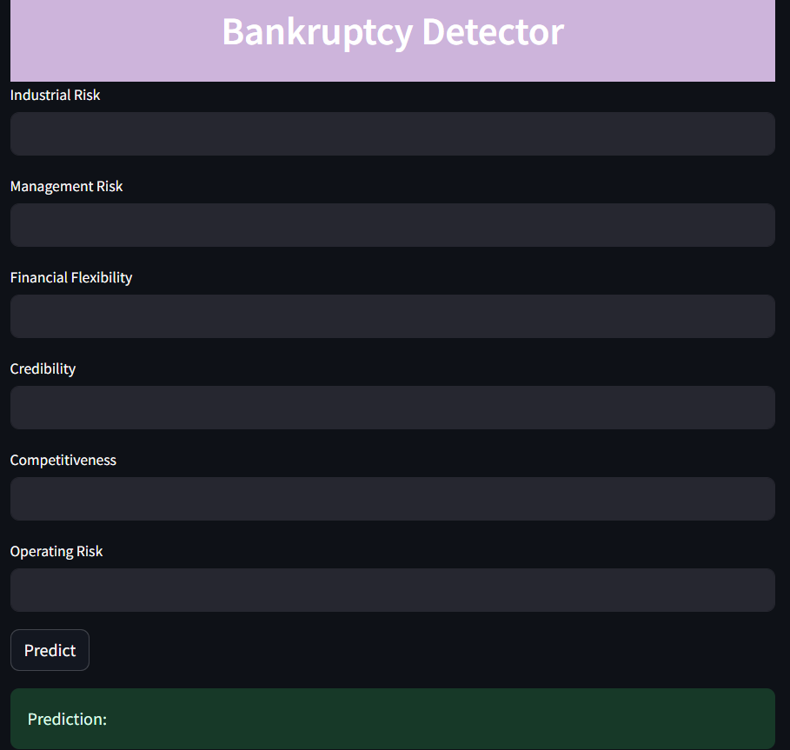
UI OF BANKRUPTCY DETECTOR APP

Slide 27


